Slide 1

Real-Time Gunshot Localization Using Acoustics
EE451: Supervised Research Exposition Presented by: Aditya Rajeev Harakare (18D100001)
Under the Guidance of: Prof. Rajbabu Velmurugan

Slide 2
Project Objectives
Study the acoustic signatures of a gunshot event
Survey the different algorithms used for gunshot localization
Existing Hardware for implementing the solution
Design a simulator in MATLAB for simulating the muzzle blast from the gunshot and the planar 4-microphone array
Develop a Python code for gunshot localization using Wavefront Curvature Method and test it on RPi using the data from the simulator
Study the effect of Noise and reflection artifacts on the location estimate

Slide 3

Introduction
Signatures left by a Gunfire
Classification of acoustic targeting devices based on mobility:
Sound of charge explosion in gun muzzle,
Light of the charge explosion,
Sound of the bullet travelling, which is only perceptible if the bullet’s speed is supersonic,
‘Sight’ of the bullet travelling,
Sound of the bullet hitting the target
Smell of the gunfire
Static Devices (city, forward camps in forests)
Vehicle-mounted
Helmet mounted or shoulder worn

Slide 4
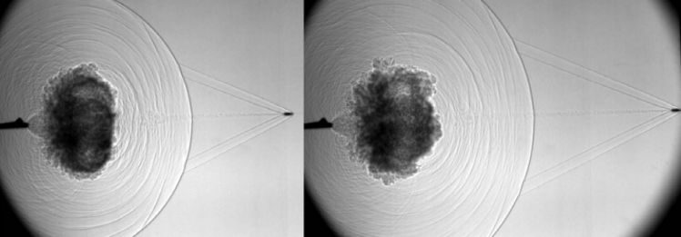
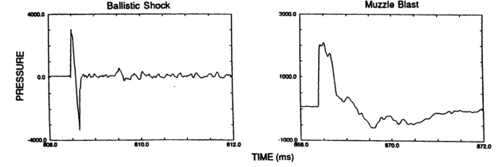
Acoustic Signature of Gunshots
Two acoustic signatures:
Muzzle Blast
Ballistic Shock Wave
Consecutive shadowgrams of the firing of a Remington .30-06 deer rifle (Settles et al., 2005).
Example pressure time series of ballistic shock wave and gun blast wave recorded from an M-16 rifle. (Stoughton, 1997).)

Slide 5
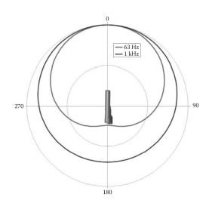
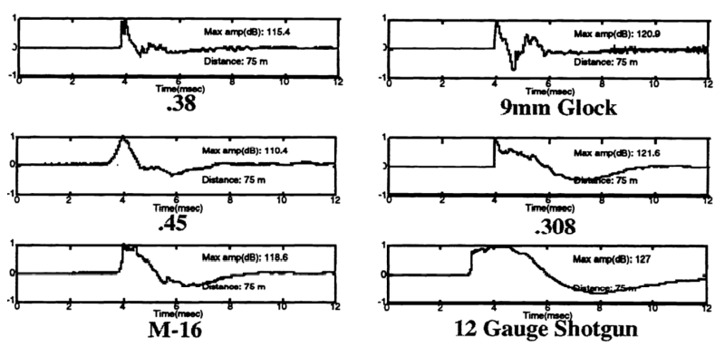
Acoustic Signature of Gunshots
Simplification of muzzle blast Directivity (J. R. Aguilar. Acoustic sensors and algorithms for urban security)
Forward direction muzzle blast waveforms for a variety of weapons (adapted from Page and Sharkey (1995)
Largest Amplitude in the direction of firing
Variation of signature for different guns; however similar shape

Slide 6
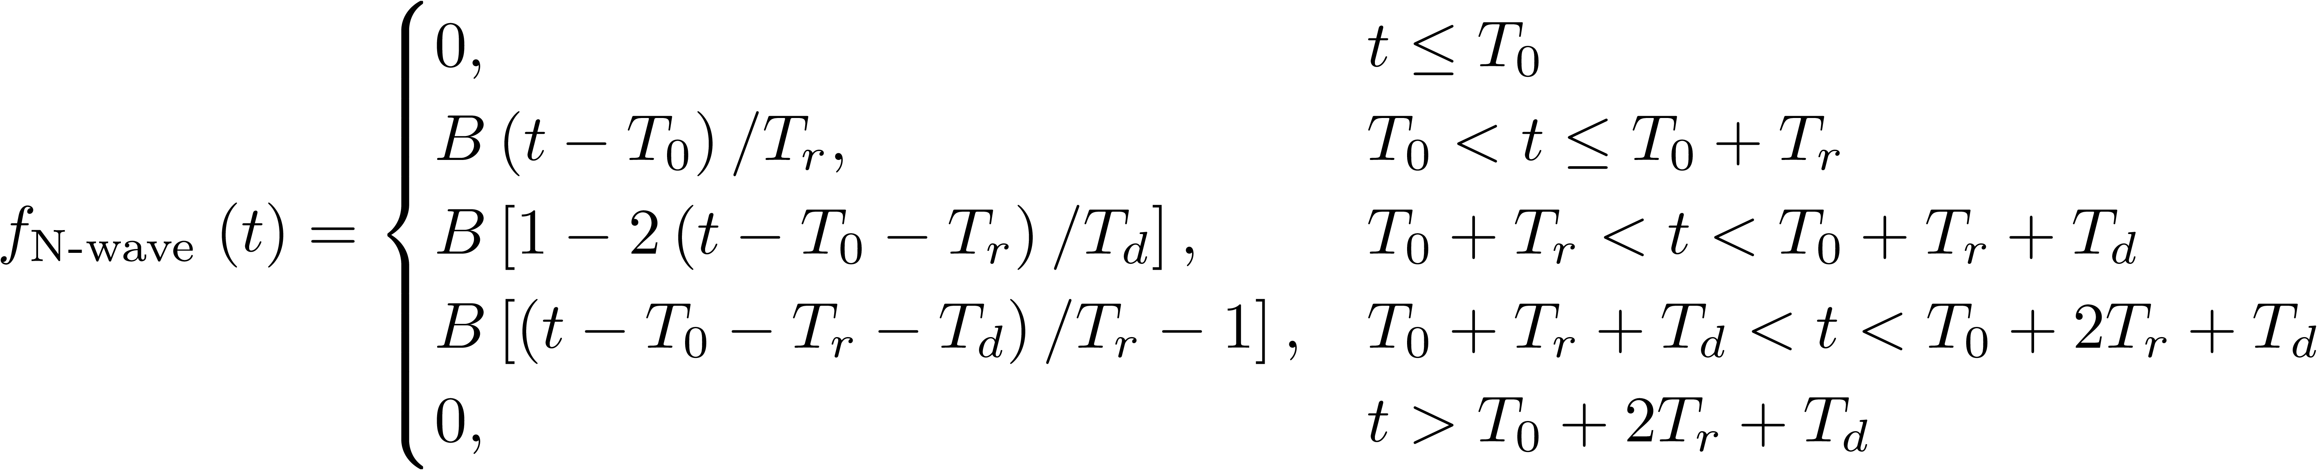
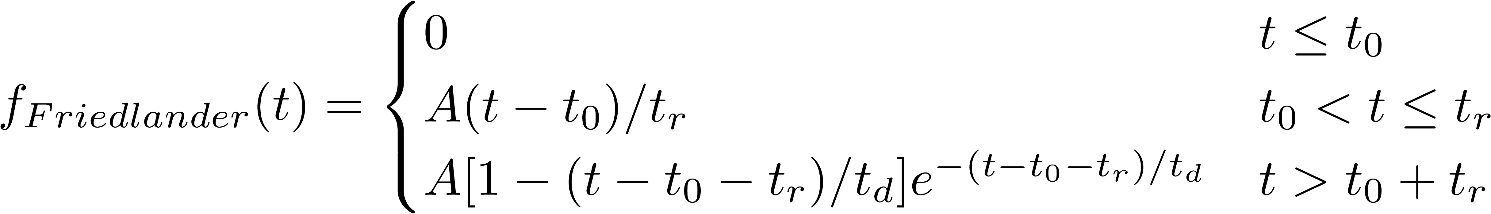
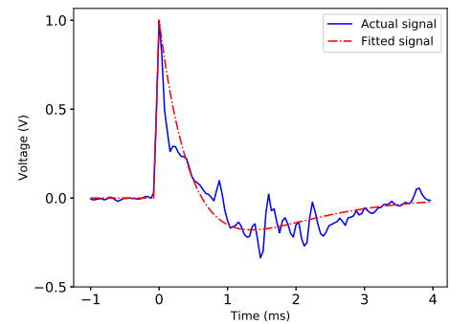
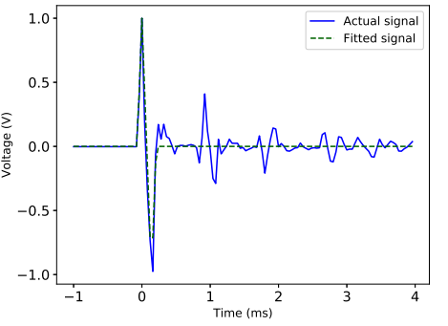
Acoustic Signatures left by a Gunshot
Muzzle Blast Signature
‘N’ Wave Signature (Shockwave)
A = peak amplitude $t_{0}$ = TOA $t_{r}$= Rise Time (Can be neglected) $t_{d}$ = Decay time
B = peak amplitude $T_{0}$ = TOA $T_{r}$= Rise Time (Can be neglected) $T_{d}$ = Decay time

Slide 7
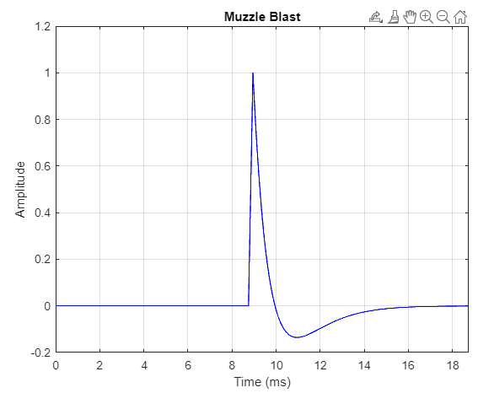
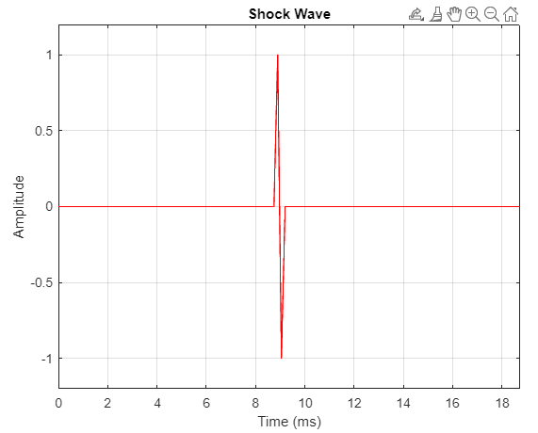
MATLAB Simulator for Data Generation
Need:
1. Non-availability of data from a gunshot 2. Validating and Testing of Localization Algorithms
Generation of Muzzle Blast and Shock Wave Signatures Using the equations of the muzzle blast and Shock Wave described previously
Simulated Muzzle
Simulated Shock Wave

Slide 8
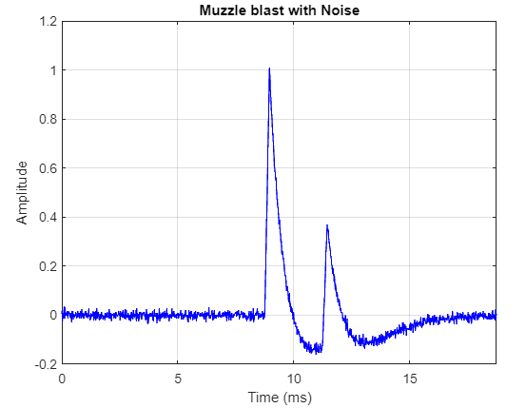
MATLAB Simulator for Data Generation
Addition of Reflections and Noise
White Guassian Noise with SNR as a tunable parameter was added to the above generated waveforms.
Reflected signal is a scaled and shifted version of the original signal. To model the ground reflection, the original signal is added with the reflected signal. The code also provides a functionality to add up-to two reflections (can be scaled easily).
Simulated Reflections and Noise in Muzzle Blast

Slide 9
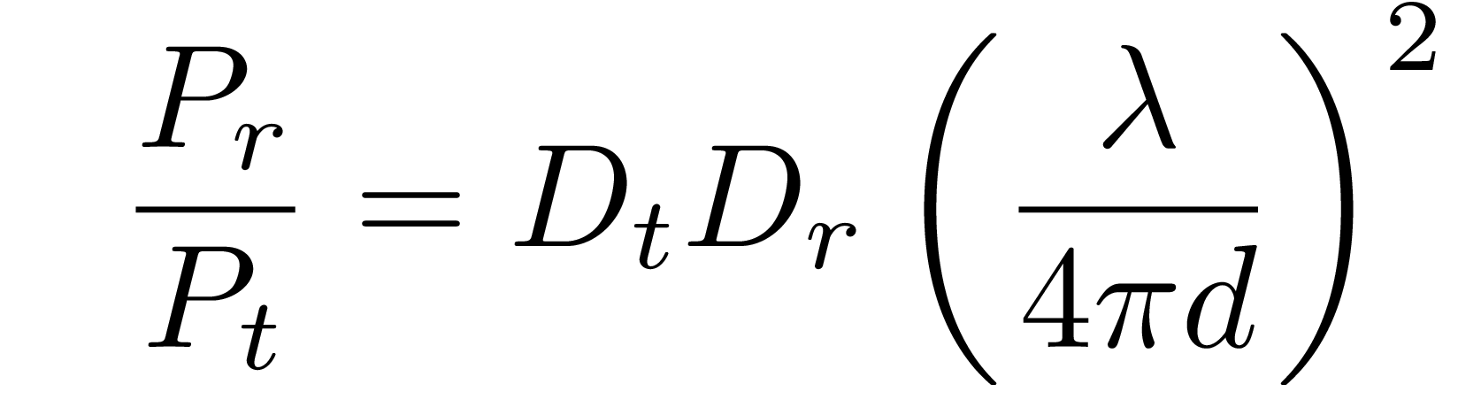
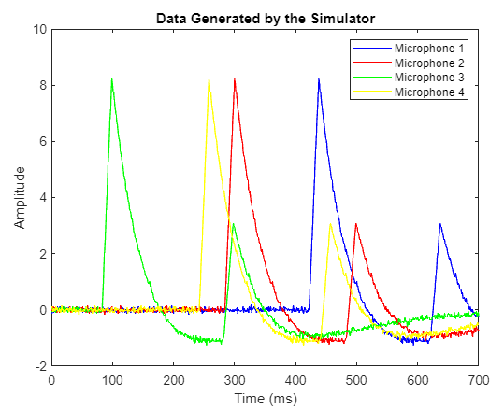
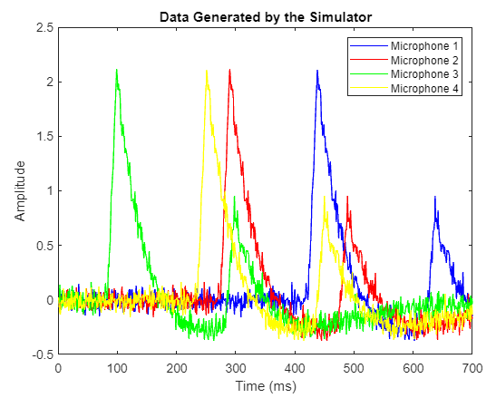
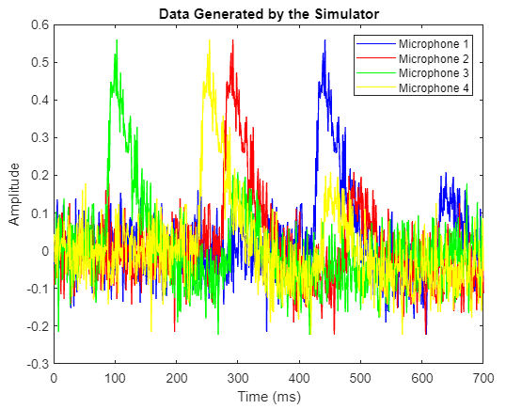
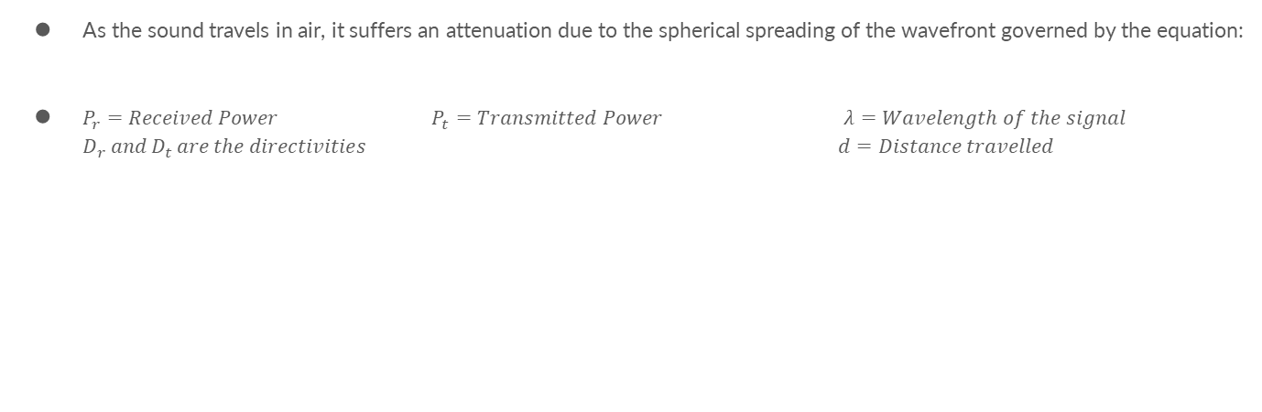
MATLAB Simulator for Data Generation
Modelling Path Loss in Air
As the sound travels in air, it suffers an attenuation due to the spherical spreading of the wavefront governed by the equation:
$P_{r}=Received Power$ $P_{t}=Transmitted Power$ $λ=Wavelength of the signal$ $D_{r} and D_{t} are the directivities$ $d=Distance travelled$
n
n
n
Distance from mic array
106.3 m
6.4 m
25.6 m

Slide 10
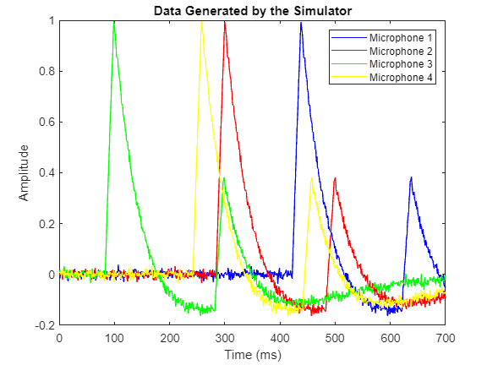
MATLAB Simulator for Data Generation
Modelling Microphone Plane
the simulator requires the following parameters:
Microphone coordinates
Coordinates of the gunshot source
Speed of Sound in Air
Based on the geometrical calculations, a 4-dimensional array of 700 elements each is generated corresponding to the 4 microphones. This data is saved in a .mat file which is later passed to the RPi for getting the location estimate.
Simulated Data generated corresponding to 4-microphone array

Slide 11
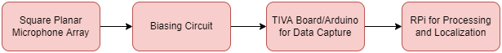
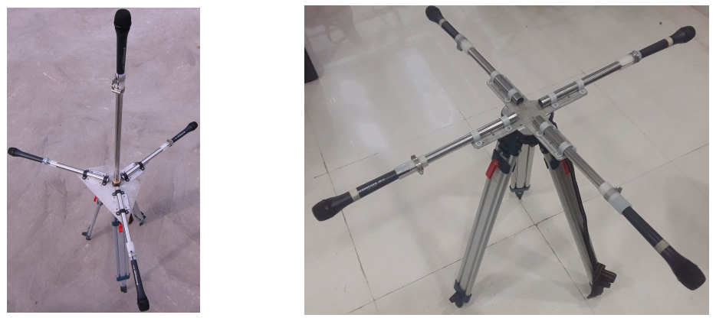
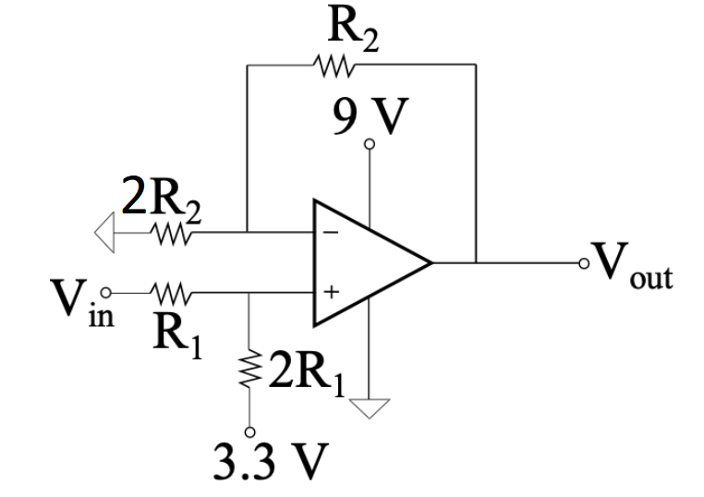
Choice of Hardware for Localization
Sennheiser MD-42 microphones sensitivity of 2 mV/Pa
Tetrahedron (3D)/Square (2D) 1m distance b/w mics
Biasing Circuit Shifting Voltage range from −1.65 to +1.65 V to 0 to 3V

Slide 12
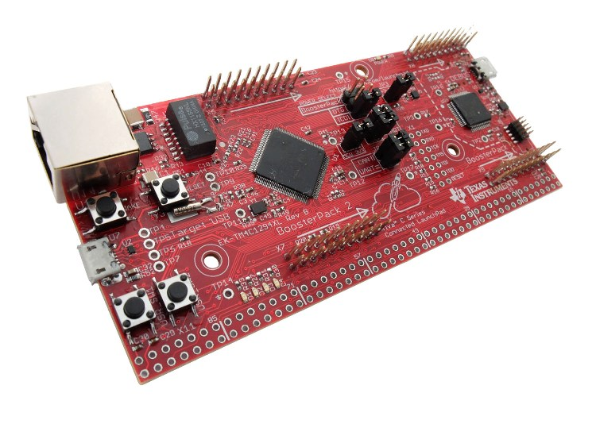
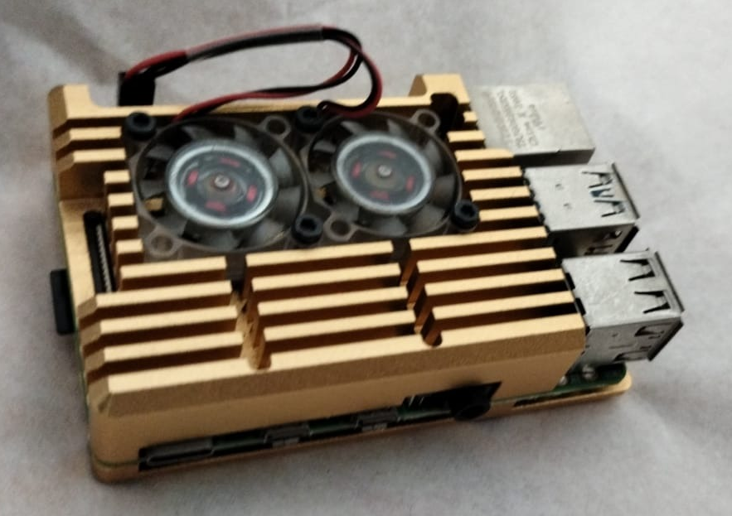
Choice of Hardware for Localization
TIVA Board for Data Acquisition Tiva C Series TM4C1294
80KSPS Sampling Rate Data buffer of 700 samples for each microphone channel
Continuously ‘listen’ on all microphone channels
Detect the acoustic event on any microphone channel
Acquire data in a brief time window (700 samples @ 80KSPS) covering the acoustic event on all four microphones, once an event is detected
Pass on the collected data over Ethernet to a downstream microprocessor (RPi in our case)
RPi board for gunshot localization Raspberry Pi 4B
Receives 4-channel microphone data through ethernet
calculate the position estimate using wavefront curvature method or non-linear least square method or both
Display/send the results as required
TIVA Board
RPi Board

Slide 13
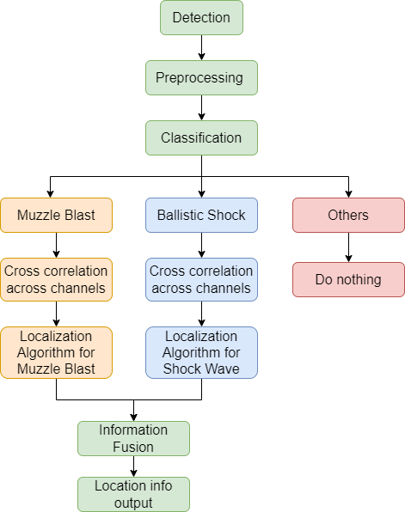
Gunshot Localization Algorithm Flow
Detection (On Sampling Device)
Threshold for the amplitude of the microphone signal.
Once the threshold is reached, we start recording the data.
Pre-processing
Noise Removal
Low pass filtering
Reflection Removal

Slide 14
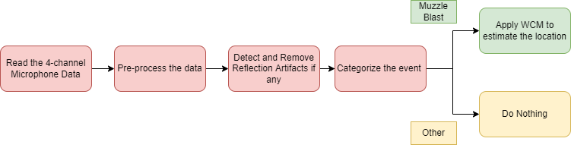
RPi Implementation of Gunshot Localization
The code for Gunshot Localization is written in Python and is divided into 5 files
main.py
preprocess.py
reflection.py
event_categorize.py
WCM.py

Slide 15
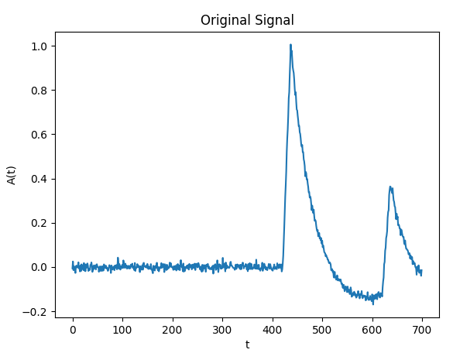
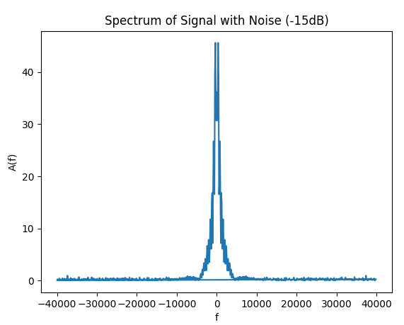
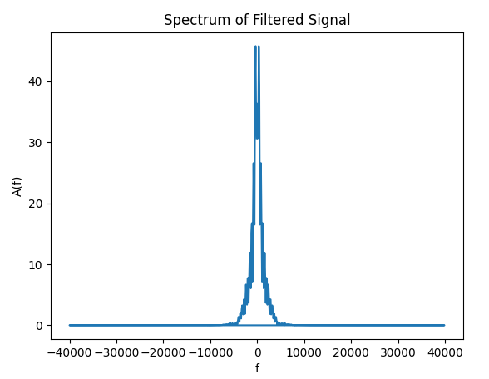
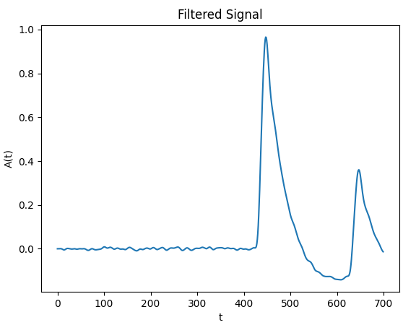
RPi Implementation of Gunshot Localization
Preprocessing the Data (Noise Removal)
The incoming data might be noisy due to the surroundings and the ambient noise sources.
The top figures are the raw data of muzzle blast (simulated with -15dB white noise) and its frequency spectrum
After applying a 5th order low-pass filter with 5000 Hz as cut-off frequency, we get the signal as shown in the bottom plots

Slide 16
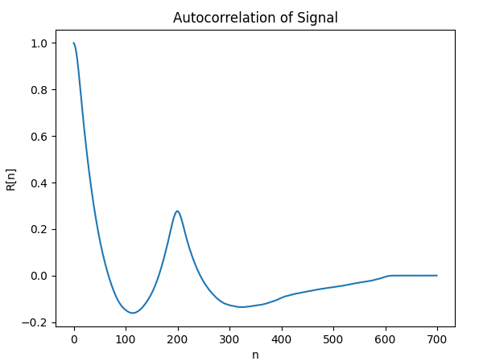
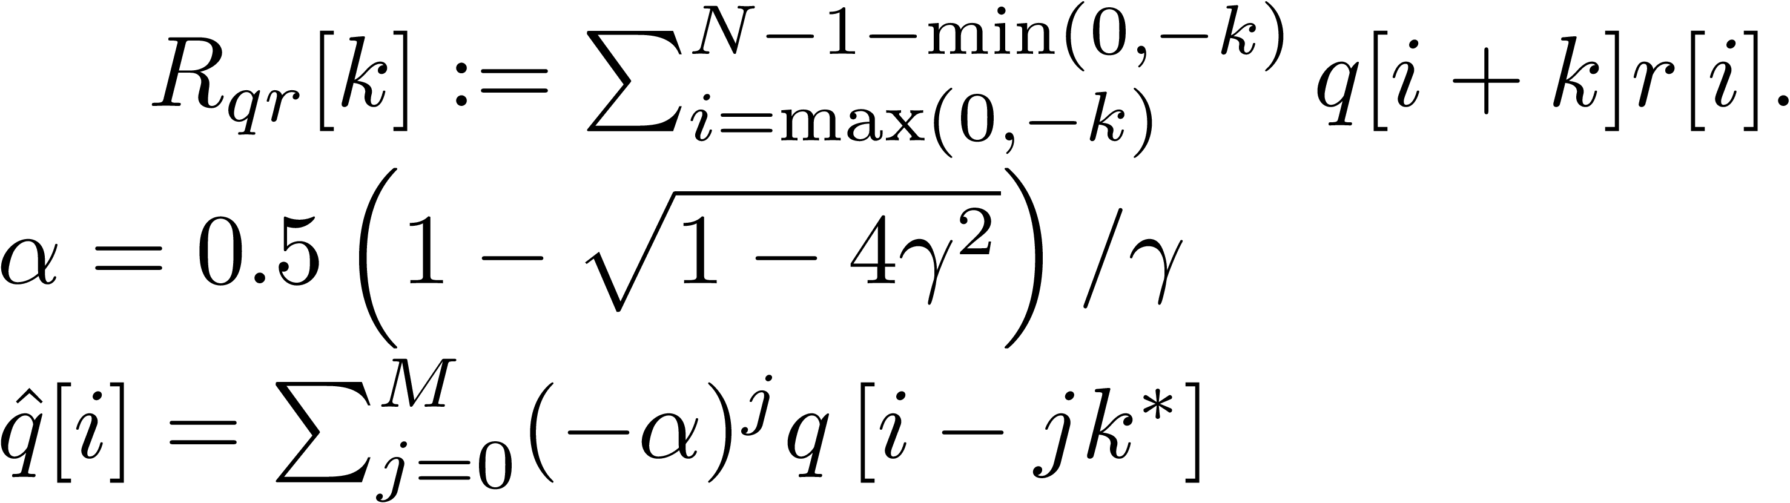
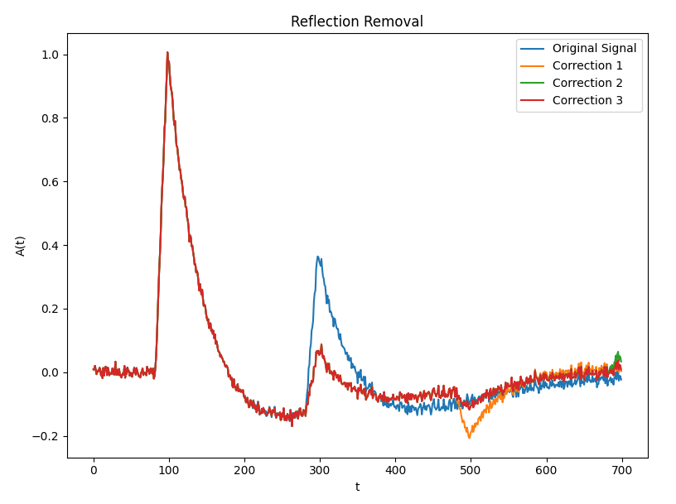
Reflection Removal
Due to reflection from the ground, a delayed and attenuated replica of the muzzle blast is recorded at the microphone
Reflection removal demo on Python (RPi)
1. Find autocorrelation
2. Find γ = Ratio of the second peak of Rqq to the peak at zero shift α = attenuation ratio
3. Delay, scale and subtract from the original signal = 1 correction M corrections:
Notes:
The detect_reflection function in the reflection.py file detects if there is a reflection artifact present in the signal. This is done by finding the autocorrelation of the signal and detecting the second peak (other than that at 0) in the autocorrelation. If a reflection is present, the correct_reflection function is called for that signal

Slide 17
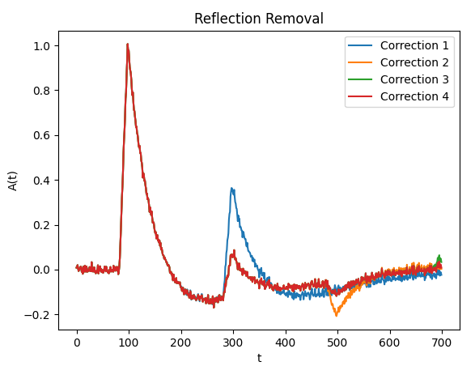
RPi Implementation of Gunshot Localization
Preprocessing the Data (Reflection Removal)
The detect_reflection function in the reflection.py file detects if there is a reflection artifact present in the signal. This is done by finding the autocorrelation of the signal and detecting the second peak (other than that at 0) in the autocorrelation. If a reflection is present, the correct_reflection function is called for that signal

Slide 18
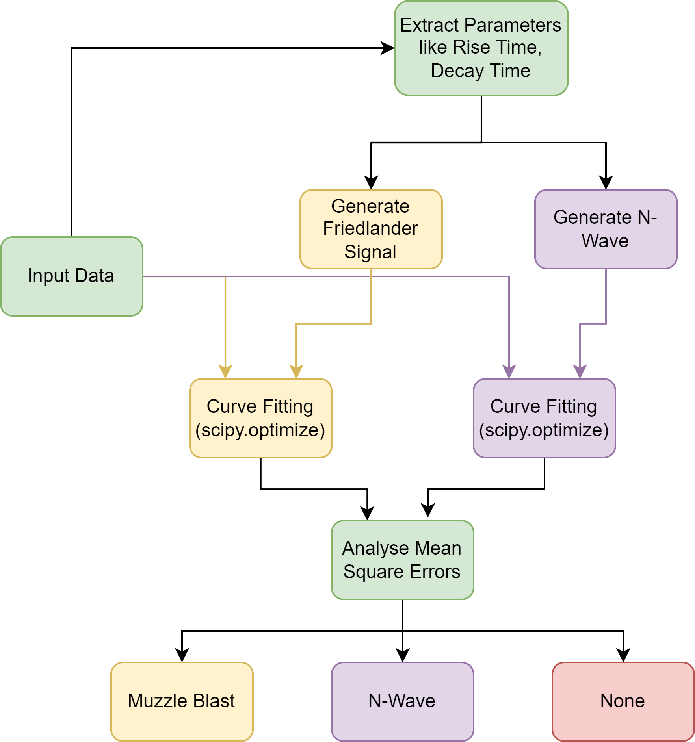
RPi Implementation of Gunshot Localization
Event Categorization
The different signatures parameters are calculated from the input data and the curve_fit function from scipy.optimize library is used to fit the 2 curves to the input data.
Based on the mean square error of data fitting, the event is categorized into muzzle blast, shock wave or none.
Demonstration of curve fitting for Muzzle Blast

Slide 19
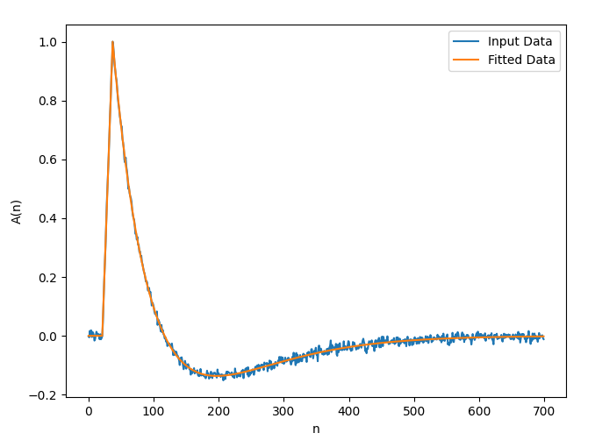
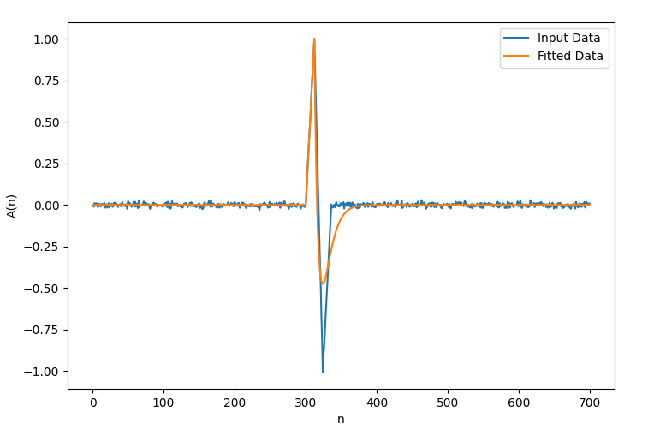
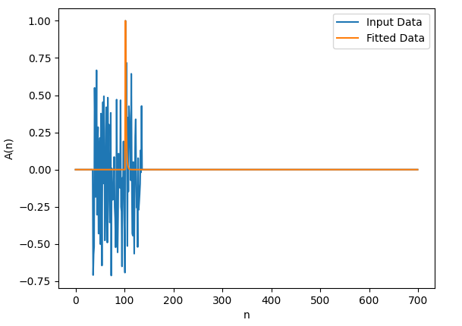
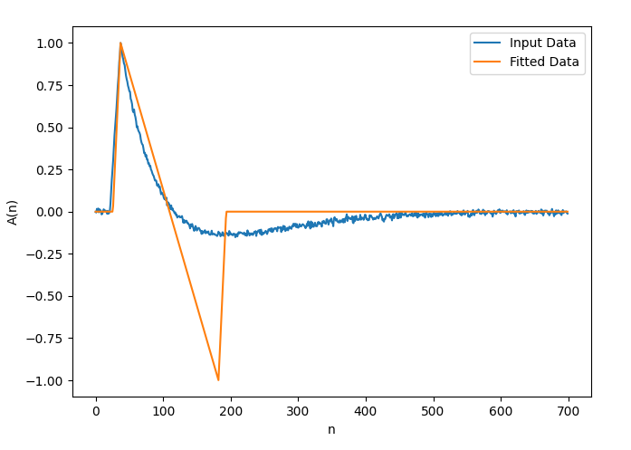
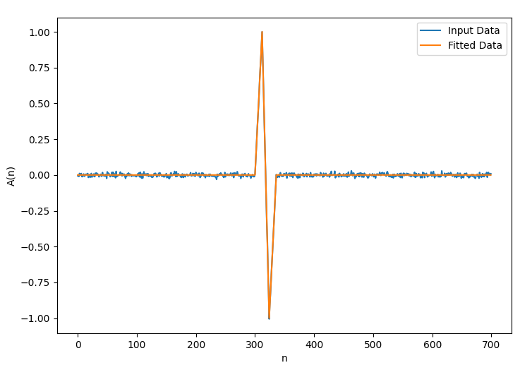
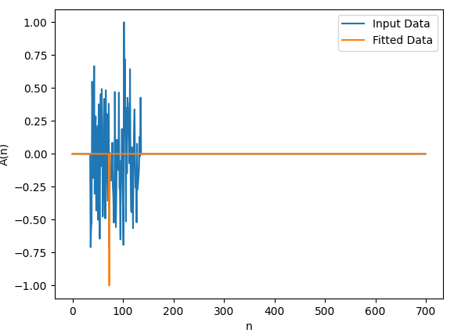
RPi Implementation of Gunshot Localization
Event Categorization
Actual Event Muzzle Blast Shock Wave Noise Pulse
Fiting
Friedlander Wave
N-Wave
MSE = 3.02e-3
MSE = 0.017
MSE = 9.66e-5
MSE = 3.25e-2
MSE = 1.07e-4
MSE = 0.018
Result Muzzle Blast Shock Wave None

Slide 20
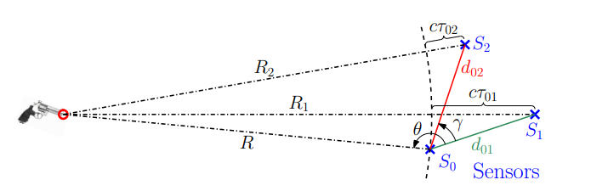
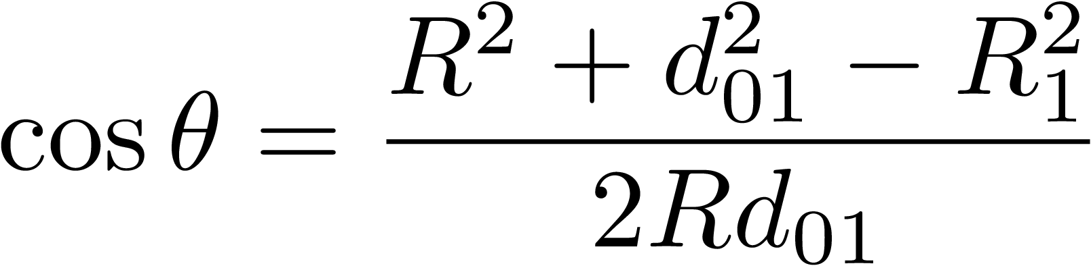
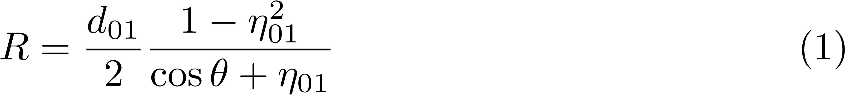
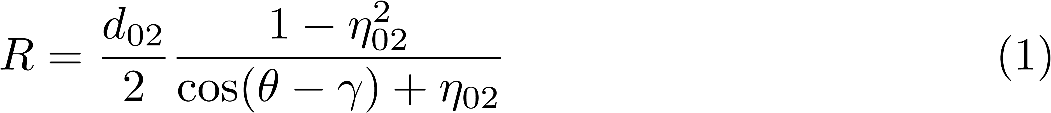
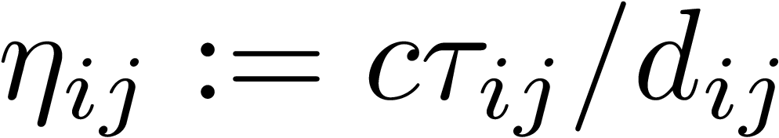
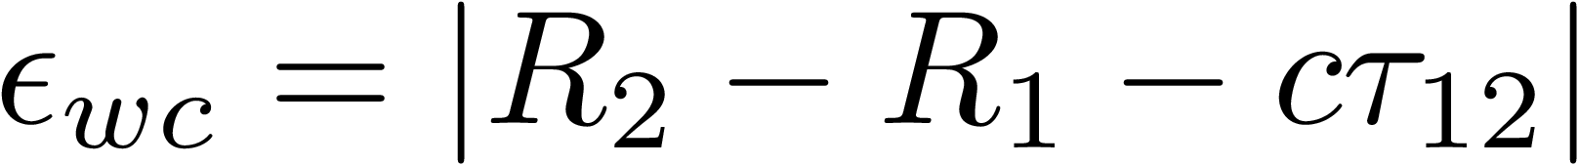
Algorithms for localizing gun-shooter from muzzle blast
Wavefront Curvature Method
Planar localization technique assuming circular wavefront expansion
Min sensors required = 3
2 mathematically possible solutions Near one to be ignored
Error:

Slide 21
RPi Implementation of Gunshot Localization
Applying Wavefront Curvature Method
The WCM.py file implements the Wavefront Curvature Method as described previously.
This is the exact geometrical solution obtained in terms of bearing angle (θ) and range R.
First the DTOAs are calculated for each microphone pair and stored in the matrix ‘Delays’.
This matrix is used to calculate the normalized TDOA and the bearing angle.
The function getValidSoln validates the candidate solutions based on range calculation and selects the one with the higher range.

Slide 22
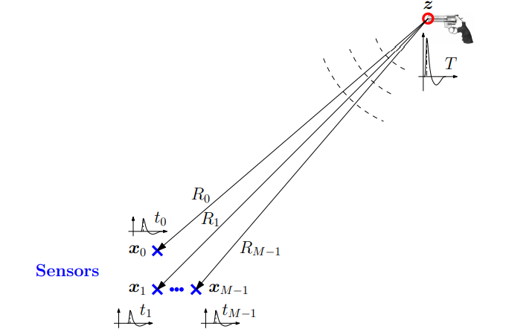
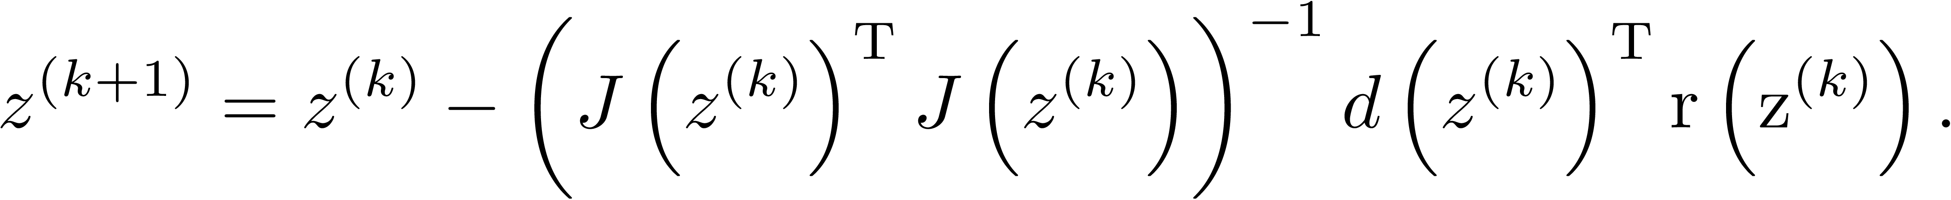
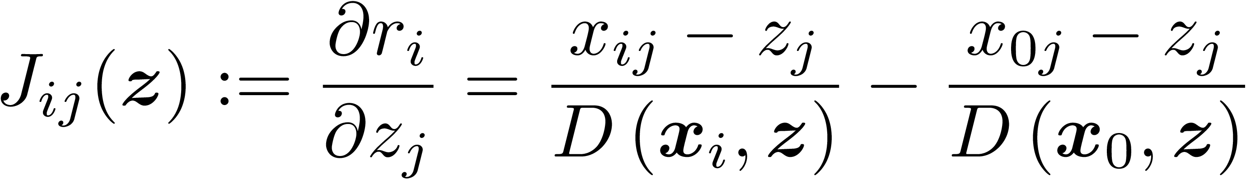
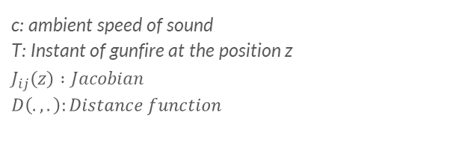
Other Algorithms for Muzzle Blast Based Localization
Non-linear least squares method
Several other algorithms like Non-linear least squares method, Bancroft’s method and Localization using multiple direction-of-arrival vectors exist
However, wavefront curvature method is very simple gives us the geometrically exact solution.
In case of multiple sensors, non-linear least square method can be used for robust computations.
We can also use this method to refine the estimate given by WCM.
c: ambient speed of sound T: Instant of gunfire at the position z $$J_{ij}\left(z\right) :Jacobian \\ D\left(.,.\right):Distance function$$

Slide 23
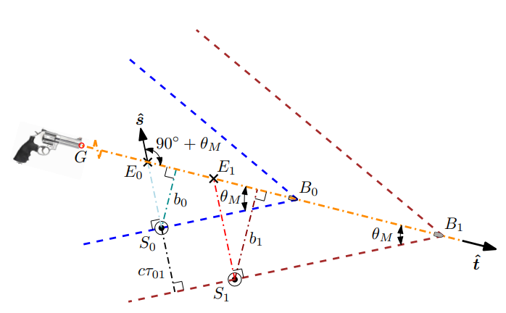





Algorithms for localizing gun-shooter from shock wave
Estimation of bullet trajectory direction
Direction of bullet trajectory (needs to be solved for approx bearing angle)
Finding a point on the trajectory
Locating the shooter
Need at least two spatially-separated clusters of sensors for solving any and all of the above localization problems
Linearity of the wavefront is a fact instead of an assumption for the ballistic shock => No requirement of the sensor array to be far from the bullet trajectory
Sensors on either side of the trajectory

Slide 24
RPi Implementation of Gunshot Localization
Results - Error Variation with Source Location
The algorithm was tried was various test cases of Source Locations (X and Y) and the error in the estimated bearing angle was computed as follows
(All Angles are in degrees)
The RMSE error observed is 0.28°. This is quite low as expected because the data used is generated from the simulator.
Test Case | X | Y | Actual Angle | Estimated Angle | Error
muzzle_test_1 | 50 | 0 | 0.000 | 0.000 | 0.000
muzzle_test_2 | 50 | 10 | 11.310 | 11.024 | 0.286
muzzle_test_3 | 50 | 20 | 21.801 | 21.987 | 0.186
muzzle_test_4 | 40 | 30 | 36.870 | 36.994 | 0.124
muzzle_test_5 | 40 | 50 | 51.340 | 51.174 | 0.166
muzzle_test_6 | 40 | 40 | 45.000 | 45.000 | 0.000
muzzle_test_7 | 40 | 70 | 60.255 | 60.329 | 0.074
muzzle_test_8 | 0 | 50 | 90.000 | 90.215 | 0.215
muzzle_test_9 | -20 | 40 | 116.565 | 116.424 | 0.141
muzzle_test_10 | -40 | 40 | 135.000 | 134.830 | 0.170
muzzle_test_11 | -60 | 0 | 180.000 | 180.000 | 0.000
muzzle_test_12 | -50 | -40 | 218.660 | 218.910 | 0.250
muzzle_test_13 | 0 | -40 | -90.000 | -89.118 | 0.882
muzzle_test_14 | 40 | -50 | 308.660 | 308.629 | 0.031

Slide 25
RPi Implementation of Gunshot Localization
Results - Error Variation with Noise Power
Performance of the localization algorithm is independent of the noise to signal ratios investigated
This behaviour can be understood by recalling the fact that cross-correlation is used to identify the DTOA for each pair of sensors in a cluster, and this is inherently robust to noise.
For Noise Power > -15dB, the algorithm fails to classify the event as it is mostly noise.
Noise (dbW) | X | Y | Actual Angle | Estimated Angle | Error
-50 | -20 | 40 | 116.550 | 116.4357 | 0.114
-40 | -20 | 40 | 116.550 | 116.4236 | 0.126
-35 | -20 | 40 | 116.550 | 116.429 | 0.121
-30 | -20 | 40 | 116.550 | 116.433 | 0.117
-25 | -20 | 40 | 116.550 | 116.4361 | 0.114
-20 | -20 | 40 | 116.550 | 116.4348 | 0.115
-15 | -20 | 40 | 116.550 | NAN | inf

Slide 26
Conclusion
Two distinct gunfire events: Muzzle Blast & Shock Wave
An attempt to design a simulator for gunshot and microphone array has been made in this project with features like original signatures, path losses, reflections and noise addition.
The gunshot location can be found out using the various signal processing techniques
Wavefront Curvature method was used after classification
The algorithms were tested on RPi 4B.
The bearing angle can be found out with very high precision as compared to the range of the gunfire.
The algorithms is almost immune to noise levels and hence filtering step in the pre-processing is somewhat redundant.
The further work in this project will be
to better the estimate using non-linear least square method
expand the scope for multiple sensors placed at different locations
Try various other techniques including DL based approaches on real life data (fire-crackers)

Slide 27
References
Github Link for the Project: https://github.com/adityaharakare1/SREGunshotLoc
J. R. Aguilar. Acoustic sensors and algorithms for urban security. In J. R. Vacca, editor, Handbook of Sensor Networking: Advanced Technologies and Applications, pages 235–248. Chapman and Hall/CRC, 2015.
A. Page and B. Sharkey. SECURES: system for reporting gunshots in urban environments. Proc. SPIE, 2497: 160–172, 1995
R. B. Stoughton. SAIC SENTINEL acoustic counter-sniper system. Proc. SPIE, 2938:276–284, 1997
J. Braasch. A precedence effect model to simulate localization dominance using an adaptive, stimulus parameter-based inhibition process. The Journal of the Acoustical Society of America, 134(1):420–435, 2013.
Real-Time Gunshot Localization Using Acoustics, Aniruddha Sinha and Hemendra Arya, May 2021
S. D. Beck, H. Nakasone, and K. W. Marr. Variations in recorded acoustic gunshot waveforms generated by small firearms. The Journal of the Acoustical Society of America, 129(4):1748–1759, 2011
R. Maher. Modeling and signal processing of acoustic gunshot recordings. In 12th IEEE DSP Workshop 4th IEEE Signal Processing Education Workshop, pages 257–261, 2006
G. C. Carter. Time delay estimation for passive sonar signal processing. IEEE Transactions on Acoustics, Speech, and Signal Processing, 29(3):463–470, 1981.
A. Kothiwala. Development of an algorithm for gun-shot localization. Master’s thesis, Indian Institute of Technology Bombay, 2017
N. Sirola. Closed-form algorithms in mobile positioning: Myths and misconceptions. In 7th Workshop on Positioning navigation and communication (WPNC), pages 38-44, 2010

Slide 28
Thank You

Slide 29

Data Acquisition and Processing on Tiva Board Online
Tiva C Series TM4C1294 Connected LaunchPad Evaluation Board
2 12-bit ADC modules
Functions:
Continuously ‘listen’ on all microphone channels (4)
Detect the acoustic event on any microphone channel
Acquire data in a brief time window
Pass on the collected data over Ethernet to a downstream microprocessor (Rpi)
DC offset correction for each microphone:
event checking algorithm starts only after 6.25 ms post boot (500 samples @80Khz)
Average of the acquired voltage values for this initial 6.25 ms is calculated for each channel to get their respective DC voltages
Pre-event data recording:
0.3ms experimental = 24 samples @80kHz
100 samples buffer implemented
Event Detection on any microphone:
Transfer sampled data to 25th entry of secondary buffer
1-24 entries of secondary buffer <= recent 24 entries of circular buffer
done for all four channels, even though the event is detected on only one channel
Secondary buffer size:
4ms gunshot event
0.3ms pre-event
√2/c = 4.2ms travel time
Total 8.5ms; 8.75ms = 700 samples
Buffer size = 4x700
Ethernet Transfer:
Secondary array filled; 2 packets transmitted for each channel:
Channel Number
Channel Data

Slide 30

Localization on RPi Board Online
Raspberry Pi Compute Module 3+
Solution:
Getting the 2-D coordinates of the source from the wavefront curvature method
providing the solution as initial guess for the classical non linear least square estimation method
100ms pause for Rpi to process
minimum time between two gunshot events
= 100ms
Time required to report the location estimate = 100ms

Slide 31

Results and Discussions
Online | Blast Wave | Square Array
WCM for initial guess
nonlinear least squares for refinement
Procedure: (4 triplets)
Choose best reference for each triplet
WCM for preliminary estimate
Calculate error for each triplet
Choose the triplet which gives minimum error
Identify best reference among all hydrophones
Non-linear least square method for refined estimate
Max error in:
Bearing Angle = 2°
Range = 40%
Offline | Blast Wave | Tetrahedral Array
25kHz Sampling
Calibrating Microphone distances based on the reverse nonlinear least-squares method
Choosing Reference microphone:
For any reference sensor, the remaining sensors yield corresponding normalized DTOA values (η’s)
Identify η_max for each sensor
Choose sensor with lowest η_max as reference
Max error in:
Bearing Angle = 3°
Range = 200%

Slide 32



Results and Discussions
Shock Wave | Security System | Simulation
500 gunshot events simulated
Max error in:
Bearing Angle = 1.75 degrees
Effect of Noise
Addition of zero-mean Gaussian noise to the ideal ‘N’-wave signal
No effect (cross-correlation is independent of Noise)

